Slide 1

Visioning the 21st Century Electricity Industry: Outcomes and Strategies for America
U.S. Department of Energy
Draft Vision of a Future Electric Grid
National Electricity Forum
February 8–9, 2012

Slide 2
The Grid Tech Team
The Grid Tech Team (GTT), with DOE-wide representation, is responsible for leadership within and outside DOE on grid modernization through strategic thinking and improved communication, coordination, and collaboration.
Establish and maintain a DOE-wide long-term vision for the future grid
DOE REPRESENTATION
Identify high priority issues and challenges to achieving the vision
Office of Science (SC)
Office of Electricity Delivery & Energy Reliability (OE)
Office of Energy Efficiency & Renewable Energy (EERE)
Advanced Research Projects Agency – Energy (ARPA-E)
Chief Financial Office (CFO)
DOE Senior Management (S1)
GRID
TECH
TEAM
Align office/ program projects and initiatives for objective consistency
Develop long-, mid-, near-term plans to address these issues

Slide 3
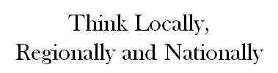
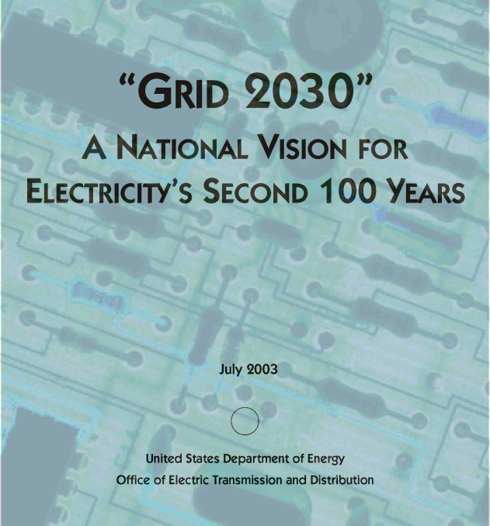
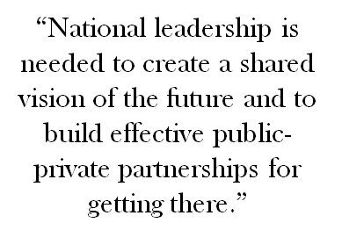
The Evolution of a National Vision
July 2003
Changing Supply Mix
Moving Forward
Enabling an
Electricity Services Economy
“Electricity as a Service”
  Access to clean energy generation and options
  Delivery of desired power quality when it is wanted
  Customer participation into electricity markets (demand response)
  Customer flexibility to use new technologies (electric vehicles, distributed generation, energy management system, etc.)
  Dynamic protection, privacy, and cyber security
  …
- Requires additional transmission
- Requires control/communications
Demand Transformation
- Expanding Digital Economy
- Power quality needs
- Demand growth
Complexity of Grid
- Expanding footprint
- Overlay of markets
- Operating “closer to the edge”
Infrastructure Vulnerability
- Interdependencies of electric and energy systems
INCREASING DRIVERS

Slide 4
Grid 2030 Roadmap (2003)
Phase I
Design and Testing
Phase II
Technology Development & Market Acceptance
Phase III
Manufacturing and Scale-up
Design
“Grid 2030” Architecture
Conceptual design
Expanded field testing and demonstrations
Expanded local and regional deployment
Prototyping
Field testing
Local and regional deployment
National Grid
Develop
Critical
Technologies
Advanced conductors and HTS
Storage
Distributed Intelligence/Smart Controls
Power Electronics
Expanded field testing and demonstrations (including distributed energy)
Expanded national and international applications
Local and regional deployment
Accelerate
Technology Acceptance
Technology transfer
Education and outreach
Introduction of advanced manufacturing and scale-up techniques
Enhanced distribution channels and O&M infrastructure
Established manufacturing infrastructure
Established distribution and servicing infrastructure
Strengthen Market Operations
Systems and market analysis
Address siting and permitting
Regulatory reforms
Jurisdiction issues clarified
Regional Planning processes in place
Market power prevention mechanisms in place
Regulations and markets in equilibrium and functioning properly
Build
Partnerships
Federal coordination
Federal-state-regions
Industry coordination
International Cooperation
Public-private partnership highly effective, running smoothly, and achieving a high level of leverage and cost sharing
Public-private partnerships efficient, effective and have global reach
2010
2020
2030
Adapted from US DOE Office of Electric Transmission and Distribution, “National Electric Delivery Technologies Roadmap: Transforming the Grid to Revolutionize Electric Power in North America”, January 2004 (available at http://energy.gov/sites/prod/files/oeprod/DocumentsandMedia/ER_2-9-4.pdf).

Slide 5
Grid Investment Drivers over Time
1990s
2003
2005
2007
2009
2011
Policies
EPAct 1992 State RPSs EPAct 2005 EISA 2007 Order 890 Order 1000
Order 888 ARRA Order 755
Order 889 EPA Utility Sector Regulations
PTC ITC
Technologies
Generation-focused
Transmission for Reliability PMUs
Energy Storage Smart Grid Demos Real-Time Data
Cyber Awareness Power Electronics Mathematics for Complex System
Markets & Operations
RTO/ISOs Federal Smart Regional Transmission Regional Plans
Grid Task Force Planning & Cost Allocation
Transmission
Investment slows Regional Interdependence Interconnection-Wide Transmission Planning
Separation of G&T; creation of regional operators (ISOs)
Northeast Blackout
ERO established; mandatory reliability standards
OATT reform;
Smart Grid investment; interconnection planning (ARRA)
Coordinated regional planning; cost recovery

Slide 6
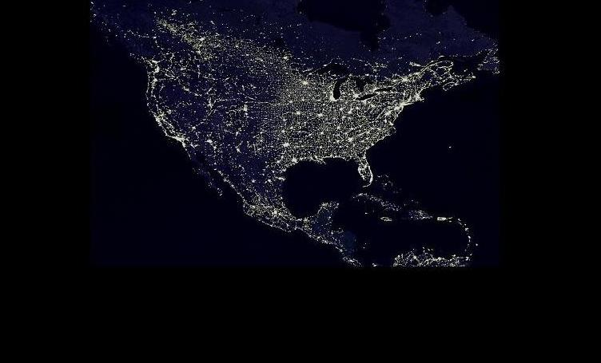
Changes to the Grid require an intricate balance of technologies, markets, and policies
DOE’s Clean Energy Goals:
By 2035, 80% of America’s electricity will come from clean energy sources
Put 1 million electric vehicles on the road by 2015
Energy related GHG emissions will reduce 17% by 2020 and 83% by 2050
  Targeted Outcomes for the Grid:
Enable better understanding and control of our electric grid by installing more than 1000 synchrophasor measurement units by 2013.
Deploy more than 26 million smart meters in American homes and businesses by 2013.
Reduce utility-scale energy storage costs 30% by 2015.
Policies drive markets which drives technologies
When finding solutions to grid challenges, all aspects need to be considered simultaneously
The Grid
Policies
state RPS, federal CES, FERC, PUC’s, environmental regulations, siting, etc.
Markets
business models, cost allocation, wholesale power trading, utilities, vendors, etc.
Technologies
generation, infrastructure, smart grid, electric vehicles,
storage, etc.

Slide 7
Vision for the Grid of the future will need to address multiple goals
Enable a seamless, cost-effective electricity system, from generation to end use, capable of meeting the clean energy demands and capacity requirements of this century, while allowing consumer participation and electricity use as desired:
  Significant scale-up of Clean Energy (80% by 2035)
  Allows 100% customer participation and choice (including distributed generation, demand-side management, electrification of transportation, and energy efficiency)
  A 100% holistically designed system (including AC-DC hybrid configurations)
  Global competitiveness and leadership
  A reliable, secure, and resilient Grid

Slide 8
Moving Forward: Targets & Direction
2011
2015
2020
2025
2030
2035
Policies
Federal/State Partnerships Enhanced Public/Private Partnerships Public/Private Partnerships Effective & Global
Regional Plans Begin Execution, Reviewed on a Regular Basis
EPA Utility Sector Regulations
Technologies
Components Resilient System
Smart Meters/DR Distributed Generation Expansion
PHEV charging stations DC Cables → Offshore Renewables AC/DC hybrid system
Substation Automation Self-Healing Distribution System
Markets & Operations
Static Load Growth Expanded Load Growth Regional Transmission Expansion
Increased Asset Utilization Dynamic System Control Nodes within Control Areas increase 5-10x
Cyber monitoring Expanded Visibility Increased potential for cyber vulnerability
100% customer participation and choice
26M smart meters
1000 synchro-phasors
1 million EV
30% energy storage cost reduction
GHG 17% reduction
80% clean energy

Slide 9
Priority Needs and Focus
Grid Tech Team Space
Generation
Transmission
Distribution
End User
Cleaner generation technologies
Accessing high quality sources of renewable energy and addressing line congestion
Accommodating increase use of EV, PV, DG, and consumer participation
Improved efficiencies in buildings and industry
Integration of renewables: improved operation, planning, etc.
Seamless connection:
two-way power flows and increased data streams
Interface with end users: deployment of AMI, microgrids, etc.
System understanding and control: visualization, communications, computation
System flexibility for stability: storage, demand response, accommodating increased variability
System security: physical security, cyber security, mitigating increased vulnerabilities
There are institutional issues/solutions that must be considered in conjunction with these technology needs

Slide 10
The Grid Tech Team Approach
Let’s look at what we’ve done
Let’s look at where we want to be
Let’s figure out how to get there, together…
The Grid
A role for DOE…
Policies
state RPS, federal CES, FERC, PUC’s, environmental regulations, siting, etc.
Markets
business models, cost allocation, wholesale power trading, utilities, vendors, etc.
Renewables Integration
Smart Grid
Advanced Modeling
Cyber Security
Energy Storage
PE/Materials
Institutional & Market Analysis
Technologies
generation, infrastructure, smart grid, electric vehicles,
storage, etc.
Other areas?

Slide 11
Renewables Integration
SC  OE  EERE  ARPA-E
What’s the challenge?
Variable renewables and their impacts on planning and operations
Impact of renewables on the distribution system
Delivery from resource locations to load (transmission)
Where are we today?
U.S. penetration less than 5% of total generation, and predominantly at transmission level
Some BAs with up to 10% capacity from variable sources; 50% at distribution
Some European countries already at much higher penetration levels
Need for coordination?
Regional transmission planning
New algorithms to support advanced modeling; Dynamic analysis
Tool development (situational awareness, forecasting, storage)
Higher penetration integration studies
Market design analysis
Where are we going?
Increasing penetration rate of variable generation - 20%... 40%... 80%?
Seamlessly integrated DG, EVs, DR
Resource-focused planning

Slide 12
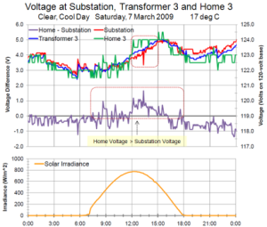
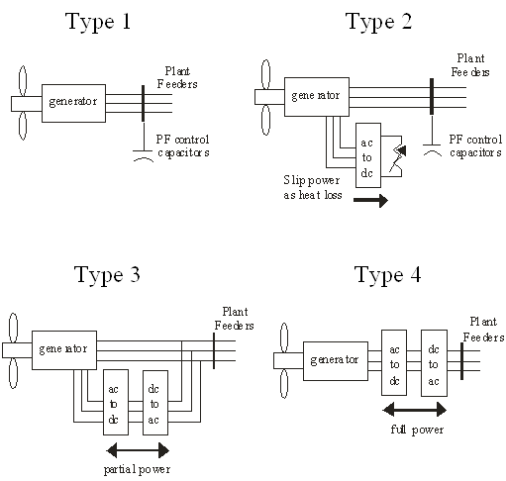
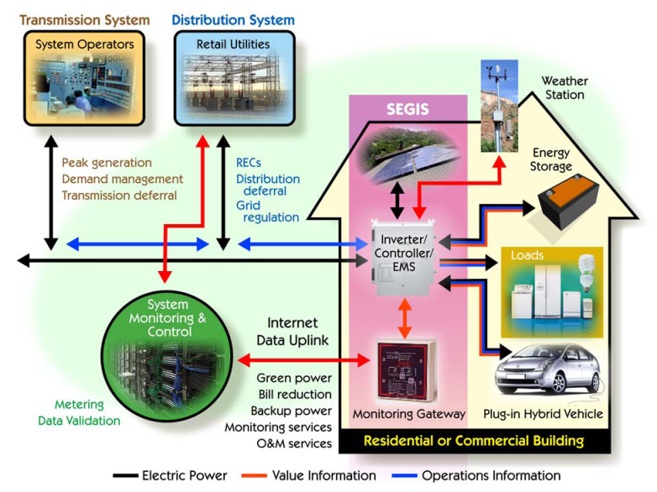
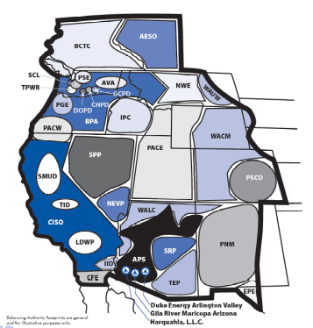
Renewables Integration
Overview of DOE Activities
  Integration studies
  Power system modeling tools
  Transmission utilization analysis
  Active power controls development
  Reserves analysis
  Testing and demonstration
  Codes and standards development
  Reliability impacts analysis
  Forecasting improvement

Slide 13

Renewables Integration
Specific Coordinated Examples
Western Wind and Solar Integration Study-Phase 2 (EERE, OE)
Eastern Renewable Generation Integration Study (EERE, OE)
Solar Energy Grid Integration Systems (SEGIS) and Solar Agile Delivery of Electrical Power Technology (ADEPT) (EERE, ARPA-E)
WECC VGS Balancing Area Analysis (EERE, OE)
Renewable Integration Model (RIM) development (OE, EERE)

Slide 14
Renewables Integration
Future Opportunities for Coordination
Leverage GTT activities through the use of improved:
  DC converter technology
  Power system modeling
  PMU data
Is DOE investing in the right activities to support the integration of clean energy sources into the grid?
What gaps exist that DOE is not working on?
How can the GTT work to better address the technical gaps that have been identified?

Slide 15
Smart Grid
SC  OE  EERE  ARPA-E
What’s the challenge?
Implement two way communication to inform consumers and grid operators
Integrate PEVs, DER and DR while better managing load
Improve electric system efficiency and reliability
Where are we today?
Recovery Act funded SGIG, SGDP, and NIST Interoperability standards, creating large-scale demonstrations/deployments
Increasing penetration of intermittent renewables and DR into T&D, emerging PEVs with aggressive penetration targets
Need for coordination?
Protection coordination of multiple
DER operations
R&D in power electronics, energy storage, smart PEV charging, and
system integration
Multi-objective microgrid development
Hybrid AC/DC structure
Where are we going?
Distribution automation
Expanded integration of DER/DR/PEV
Cost-effective microgrid development
Integrated T&D modeling and analysis
NIST/IEEE standards implementation
Business case development

Slide 16
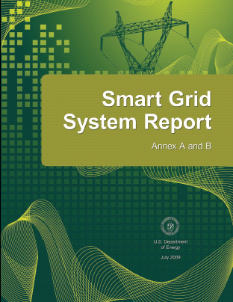
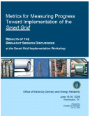
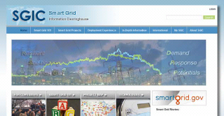
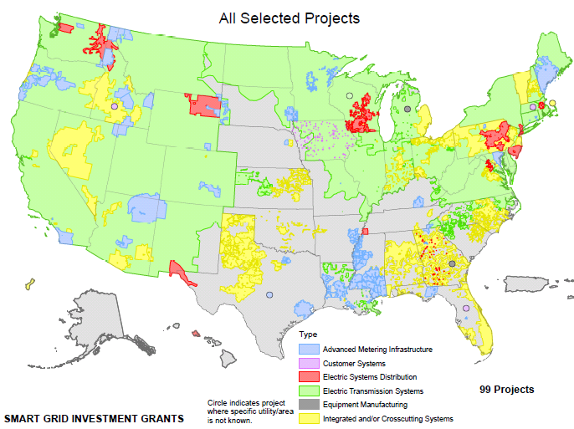
Smart Grid
Overview of DOE Activities
ARRA
  Smart Grid Investment Grant (SGIG)
  Smart Grid Demonstration Projects (SGDP)
  Workforce Training
Smart Grid R&D
  Standards (NIST, IEEE)
  Technology Development
  DER Models
Energy Efficiency programs
  Demand response
  Energy efficiency integration
  State Technical Assistance

Slide 17
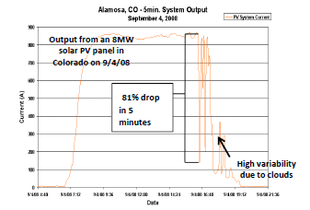
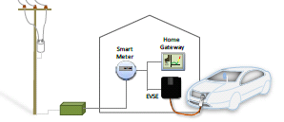
Smart Grid
Specific Coordinated Examples
Smart Grid Task Force, a federal
task force coordinating SG activities
(EERE, OE)
Western Renewable Energy Zones initiative, integration of renewables modeling (EERE, OE)
Grid Interaction Tech Team*, which coordinates PEV adoption through public-private partnerships (EERE, OE)
Consumer Engagement, participation of building/industrial loads in ancillary services (EERE, OE)
GRIDS, ADEPT, GENI (ARPA-E, OE)
* The Grid Interaction Tech Team (GITT) addresses connectivity between light duty plug-in vehicles, the charging infrastructure and the electric power grid

Slide 18
Smart Grid
Future Opportunities for Coordination
Support Technologies: Develop and bring to market power electronics and energy storage for smart grid applications
Standards: Set and evaluate cyber and integration standards
PEVs: Develop, demonstrate and deploy smart charging of PEVs
Pilots: Develop and pilot the future grid concepts
Planning/Development: Develop and demonstrate smart energy communities or cities, with integration of grid, water, transportation, building, and sustainable fuel infrastructures
How can DOE leverage its current work to move smart grid forward?
What research is needed to advance smart grid?
How can the GTT work to better coordinate smart grid research and development?
Where are the gaps that require coordination within DOE?

Slide 19
Advanced Modeling
SC  OE  EERE  ARPA-E
What’s the challenge?
  Future generation resource mix unknown and load profiles uncertain
  Breadth and depth of “smart grid” data (data overwhelm); vulnerabilities continually emerging
  Boundary seams (planning, modeling, and operations) critical for effective integration with legacy systems
Where are we today?
Real-time system monitoring by operators is supported by offline engineering analysis (high latency)
Operator trying to make control decisions, especially quickly during a disturbance, based on incomplete data
Inconsistencies in planning and operations assumptions/models
Need for coordination?
Strategic modeling approach for the holistic understanding and design of a complex system of grid systems
New algorithms, techniques, and computational approaches
Validation and verification of tools, techniques and models on actual power system problems (and data)
Where are we going?
New models, planning, and operational tools that are well integrated and used by industry for real-time system control
Improved flexibility and reliability through better system understanding
Address a variety of market structures; increased engagement (services and roles)

Slide 20

Advanced Modeling
Overview of DOE Activities
Basic Research
  multi-scale modeling, optimization, stochastic simulations, uncertainty quantification, large-scale data analysis and data management, and visualization
Transformational energy research
  innovative control software and control architectures
Applied research
  accelerate performance and enhance predictability of power systems operational tools; development of new software platforms and capabilities using time-synchronized data, e.g. phasors; reliability modeling in support of regional and interconnection planning
  development of non-proprietary models of wind generators and inverter technologies for use in transmission planning/interconnection studies
  use of stochastic simulations for generation dispatch

Slide 21

Advanced Modeling
Specific Coordinated Examples
Improved Power System Operations Using Advanced Stochastic Optimization
  Parallel algorithms and software for solving stochastic optimization problems (SC)
  New commitment/dispatch/ pricing formulation and models that uses probabilistic inputs to account for uncertainty (ARPA-E, SC, OE)
  Real-time tools and platforms for balancing demand-side flexibility and supply-side variability (OE, EERE, ARPA-E)
  Renewable integration model (RIM) for multi-timescale power-flow analysis (OE, EERE)
Fusing Models and Data for a Dynamic Paradigm of Power Grid Operations
  Calibrated real-time dynamic model (SC)
  Look-ahead dynamic simulation (OE)
  Dynamic contingency analysis (OE, ARPA-E)
Exploring Power Systems Models using Nonlinear Optimization Techniques
  New toolkit for solving nonlinear optimization problems (SC)
  Modular suite of test problems using either DC or AC (linear or nonlinear) transmission models (OE)
  Explore effect of AC & DC models for transmission switching (OE, ARPA-E)
Power Grid Planning and Operation:
From Reactive to Predictive
Dynamic States
Data collection cycle
Dynamic contingency analysis
Look-ahead dynamic simulation
Calibrated real-time dynamic model
1/30 sec
2/30 sec
3/30 sec
1 min
Time
21

Slide 22
Advanced Modeling
Future Opportunities for Coordination
Accelerate Performance: improving grid resilience to fast time scale phenomena that drive cascading network failures and blackouts
Enable Predictive Capability: real-time measurements and improved models to represent the operational attributes of the electric system, enabling better prediction of system behavior and thus reducing margins and equipment redundancies needed to cover uncertainties
Integrate Modeling Platforms (across the system): capturing the interactions and interdependencies that will allow development (and validation) of new control techniques and technologies
What characteristics are necessary for new model (or operator tool) development for the future electric grid?
How can this community work together to facilitate the availability of data for model validation and verification?
How do we foster a community of mathematic, computational, and power systems expertise to address these technical challenges?

Slide 23
Cyber Security
S1  OE
What’s the challenge?
Reliable energy delivery depends on cyber-security in the modernized energy sector’s complex communication architectures that transmit real-time data and information for operations
Increasingly sophisticated cyber-threats directly target the energy sector
Where are we today?
Cyber-resilience of energy delivery systems varies across the Nation
Some entities have sophisticated capabilities to detect, prevent and respond to cyber-incidents
Some entities are at the beginning stages of establishing cyber-resilience
Need for coordination?
All energy sector stakeholders, public and private sector, must actively engage
Accelerate frontier cyber-research into real-world energy sector operations
Stay ahead of emerging threats, vulnerabilities and consequences
Interoperable cyber security standards
Where are we going?
Resilient energy delivery systems are designed, installed, operated and maintained to survive a cyber incident while sustaining critical functions.

Slide 24
Cyber Security
Overview of DOE Activities
ROADMAP STRATEGY
Build a Culture of Security
  Cyber security practices are reflexive and expected among all energy sector stakeholders
Assess and Monitor Risk
  Continuous security state monitoring of all energy delivery system architecture levels and across cyber-physical domains is widely adopted by energy sector asset owners and operators
Develop and Implement New Protective Measures to Reduce Risk
  Next-generation energy delivery system architectures provide “defense in depth” and employ components that are interoperable, extensible, and able to continue operating in a degraded condition during a cyber incident
Manage Incidents
  Energy sector stakeholders are able to mitigate a cyber incident as it unfolds, quickly return to normal operations, and derive lessons learned from incidents and changes in the energy delivery systems environment
Sustain Security Improvements
  Collaboration between industry, academia, and government maintains cybersecurity advances

Slide 25
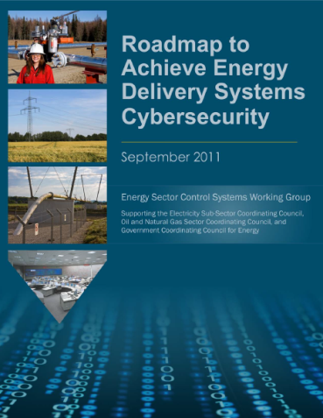
Cyber Security
Future Opportunities for Coordination
Energy Sector’s synthesis of critical control system security challenges, R&D needs, and implementation milestones
Provides strategic framework to
  align activities to sector needs
  coordinate public and private programs; success requires partnership from the start
  stimulate investments in control systems security
How can communication (and collaboration) amongst energy sector stakeholders be improved?
What are some innovative approaches to partnerships? Do the nature of the partnerships (or stakeholders themselves) change as the power system evolves?
This is a continually evolving activity that does not need to be reactive; how can we position ourselves to anticipate and protect?

Slide 26
Energy Storage
SC  OE  EERE  ARPA-E
What’s the challenge?
Costs of energy storage systems
  Cost/Benefit ratio too low
Lack of data for projects
  Questions about reliability
Utilities are generally conservative
Regulatory treatment of energy storage
Where are we today?
Energy storage is utilized in the grid primarily for diurnal energy storage (primarily pumped hydroelectric plants)
16 ARRA demonstration projects
New technology being developed – advanced batteries, flow batteries, flywheels
Need for coordination?
Building effective public–private partnerships to achieve RD&D goals
Complementary approaches needed to accelerate breakthroughs
  Basic electrochemistry
  Device development
  Bench and field testing of systems
Where are we going?
Reduce grid storage costs 30% by 2015
Develop multiple commercial technologies for multiple applications
Develop new materials and technologies to revolutionize energy storage
Develop value proposition for storage applications
26
Notes:
26

Slide 27
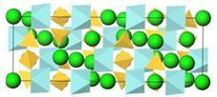
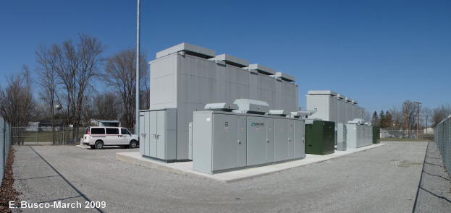
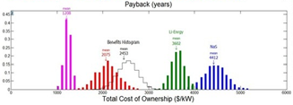
Energy Storage
Overview of DOE Activities
Research
  Create the next generation of storage technology options based on advanced and nano-formed materials
Demonstration/Deployment
  Test and demonstrate Energy Storage system technologies
System Analysis
  Model and simulate energy storage systems to guide development and deployment
27

Slide 28
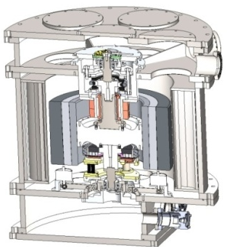
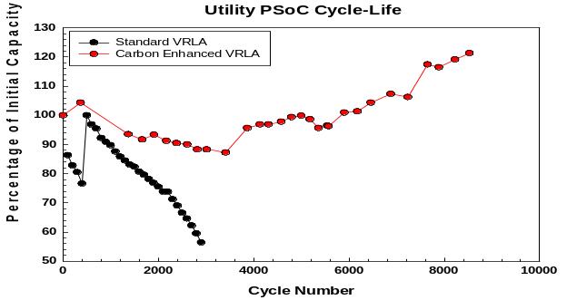
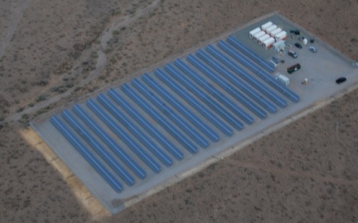
Energy Storage
Specific Coordinated Examples
A123 Systems’ nano-structured cathode material for battery applications
  Office of Science sponsored basic research
  BES SBIR grant
  EERE grant
  OE-supported demonstration project
Evaluation of storage to complement renewable generation
  Grid Level Integration (OE)
  Residential PV (EERE)
Development of new energy storage technology prototype device
  High-risk investments (ARPA-E)
  Testing & device development (OE)
Economic analysis
  Grid Benefits (OE)
  Wind Integration (EERE)
Joint Peer Reviews (OE, ARPA-E, SC)
Working with private companies & universities to increase performance (OE, ARPA-E)
  ARPA-E working with Boeing on development of alternative low-cost material to reduce overall flywheel system cost
  CRADA with East Penn Mfg. to establish
  mechanisms of PbC battery performance
  enhancement
BES exploration of new electrochemical processes & concepts; fundamental
materials research (SC)
Deployment projects (ARPA-E, OE, EERE)
  PNM Prosperity Energy Storage Project –
  Integrated PV + PbC Storage
  Analysis of storage and renewable on the grid
28

Slide 29

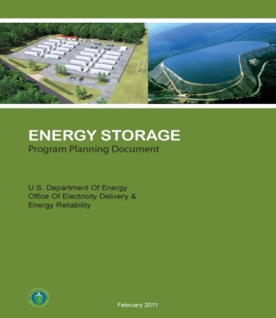

Energy Storage
Future Opportunities for Coordination
Collaborate with SBIR, EFRCs, and through university solicitations, to mine sources of new ideas
Initiate efforts in discovering new materials and chemistries to lead new energy storage technologies
Analyze current demonstration projects
Deploy new demonstration projects
Assess new, promising technologies
Scale up production capacity
Battery/Storage Hub
Grid/Storage Analytical Studies
Utility Needs
Storage Program Plan
Materials
Requirements
What analysis should we do to support industry?
What balance of research, device development, and field testing is appropriate?
How can we work more closely with industry to bring energy storage to deployment?
29

Slide 30
Power Electronics/Materials
SC  OE  EERE  ARPA-E
What’s the challenge?
Increased need for energy conversion and power flow control
Capabilities for efficient, long-distance or off-shore energy transfers
Materials, devices, and systems that can handle high power and extreme operating conditions
Where are we today?
Use of HVDC and FACTS devices is very expensive
The material backbone of the electricity delivery system hasn’t changed
R&D in wide band gap semiconductors have shown improved performance over silicon
Need for coordination?
Understanding fundamental material properties and novel functionalities
Reducing the costs of wide band gap semiconductors and the associated devices and systems
Identifying new applications for novel materials
Where are we going?
High-performance, cost-effective power electronic systems
Materials for self-healing, embedded sensing, and dynamic reconfigurations
Enhanced material properties for insulators, conductors, magnetics, etc.

Slide 31
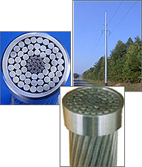

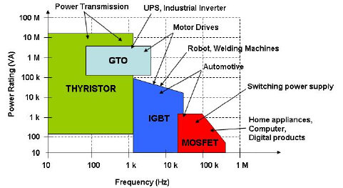
Power Electronics/Materials
Overview of DOE Activities
Use-Inspired Basic Materials Research
  Wide band gap semiconductors
  Insulators for power cables
  New materials and composites for conductors
  Simulations and defect analyses
Applied Materials Research
  Aluminum conductor composite reinforced overhead cables
  Advanced solid-state (SiC, GaN) switches for power electronics applications
  Next-gen magnetics and conductors for improved generators and electric motors

Slide 32
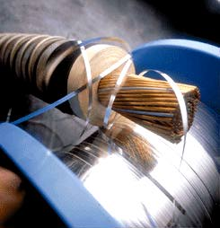
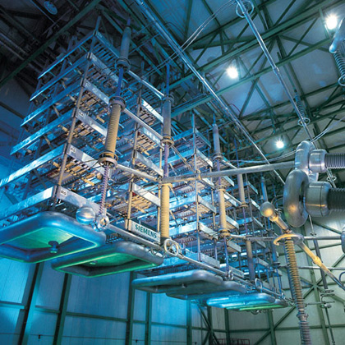
Power Electronics/Materials
Specific Coordinated Examples
High Temperature Superconductors (HTS)
  Basic materials research (SC)
  Development of HTS underground cables (OE, SC)
  Field testing (OE)
Inverters for grid applications
  Solar BOS cost reduction (ARPA-E, EERE)
  EV charging (EERE)
  Power electronic devices R&D (OE, ARPA-E)
Transformative Technologies
  Joint GENI peer-review (SC, OE, ARPA-E, EERE)

Slide 33
Power Electronics/Materials
Future Opportunities for Coordination
Enhance public-private partnerships for the development of:
  Solid state transformers and cost-effective power converters
  HVDC circuit breakers
  Next generation cables and conductors
  Advanced materials with self-healing for improved resiliency and embedded sensing
Demonstration, testing, and analysis of new technologies and material properties
How will planning and operations change if HVDC and FACTS devices become significantly cheaper?
Will power electronics be a critical asset to manage a more asynchronous grid with higher penetrations of variable renewables?
What functionalities or material properties are desired for the future grid?
How can DOE better connect the applied offices with the Office of Science?

Slide 34
Institutional & Market Analysis
S1  OE  EERE  SC
What’s the challenge?
Existing markets, business models, and institutions need to evolve to meet needs raised by new and emerging technologies
Additional and ongoing coordination needed among government agencies and stakeholders at many geographic levels
Where are we today?
Increasing focus on collaborative regional and interconnection-wide planning
Improved coordination among Federal agencies for renewables development and transmission expansion
Need for coordination?
Federal and state agencies, NGOs need to participate in grid planning
Regional cooperation on resource development, market issues and transmission expansion
Grid operations will require even more intensive coordination in near-real-time
Where are we going?
Seamless, reliable, and efficient markets that allow for interstate transmission, access to distant generation resources, and also allow participation by DG, DR, storage, and other non-traditional technologies
Increased stakeholder outreach

Slide 35
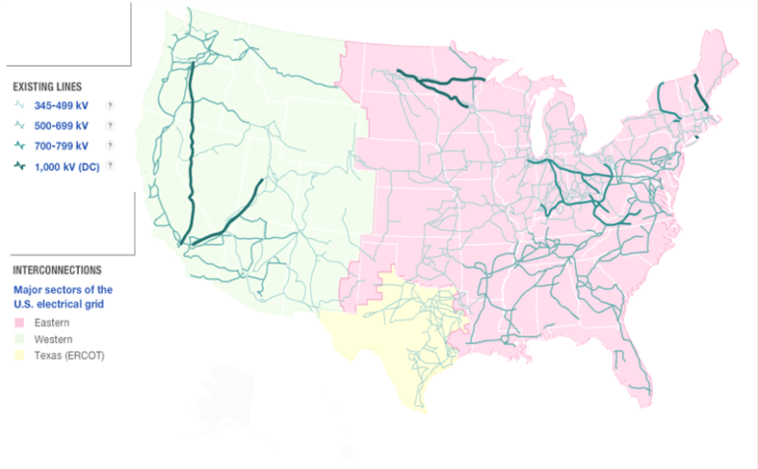

Institutional & Market Analysis
Overview of Key DOE Activities
Support for States and Regions: interconnection planning, grants, partnerships
Expand Transmission:
  leverage PMA’s transmission networks through support for selected new projects
  improve federal process for review of pending projects (Interagency Rapid Response Team /Transmission)
Analyses: identify needed infrastructure in the U.S.; identify high-impact transmission expansion opportunities within PMA footprints; triennial congestion studies; state of electricity markets

Slide 36

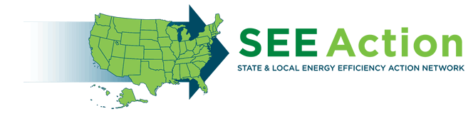

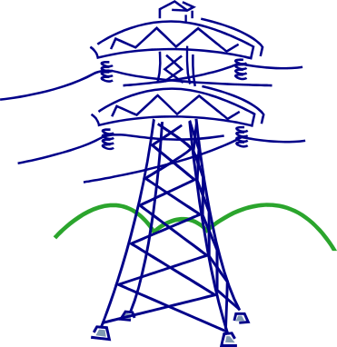
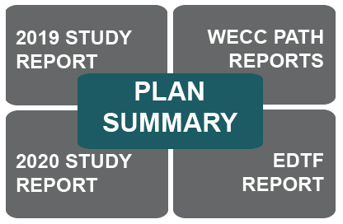
Institutional & Market Analysis
Specific Examples of Coordinated Efforts
Interagency Rapid Response Team for Transmission (S1, OE, EERE, other federal agencies)
State Energy Efficiency Action Network (OE, EERE)
Hawaii Clean Energy Initiative (OE, EERE)
Siting on Federal and Tribal Lands (OE, EERE, S1)
Interconnection-Wide Transmission Planning (OE, EERE, S1, other federal agencies)
Transmission Reliability Program (OE, SC)

Slide 37
Institutional & Market Analysis
Future Opportunities for Coordination
Planning and Coordination: Seek maximum benefits from FERC Order 1000, which requires regional and subregional groups to do open and collaborative long-term grid planning. Planners must take into account non-wires alternatives, state/local policies, and consult with neighboring planners about new lines crossing shared borders. Strong participation by states, federal agencies, and NGOs will be crucial to success.
Analyses and Tools: assess new markets, business models, revenue streams, and policies; support development of new analytic techniques and tools; evaluate balance of AC and DC within T&D; quantify T&D investments and benefits
Education and Outreach: expanded technical assistance to States and other stakeholders on market implications, regulations, and operations
What institutional barriers and issues will be most critical as new grid technologies emerge and transform grid operations?
What roles should DOE take on to address these barriers and through what mechanisms?

Slide 38
Grid Tech Team Actions
Continue the dialogue towards a National Public-Private Vision of the Future Grid
  November 2011: Grid Tech Team vetting meeting
  December 2011: PSERC meeting
  January 2012: Webinar (tentative)
  February 2012: National Electricity Forum meeting
Follow-up Discussion - mechanism?
Next Steps:
  Develop National Vision document
  Develop Strategy for Coordinated DOE Grid Activities/Priorities
The Grid Tech Team
Lauren Azar (S1)  Gilbert Bindewald (OE) Charlton Clark (EERE)  James Davenport (SC)  Jennifer Downes-Angus (CFO)  Imre Gyuk (OE) Mark Johnson (ARPA-E)  Sandy Landsberg (SC)  Kevin Lynn (EERE)  David Meyer (OE)  William Parks (OE)  Rajeev Ram (ARPA-E)

Slide 39
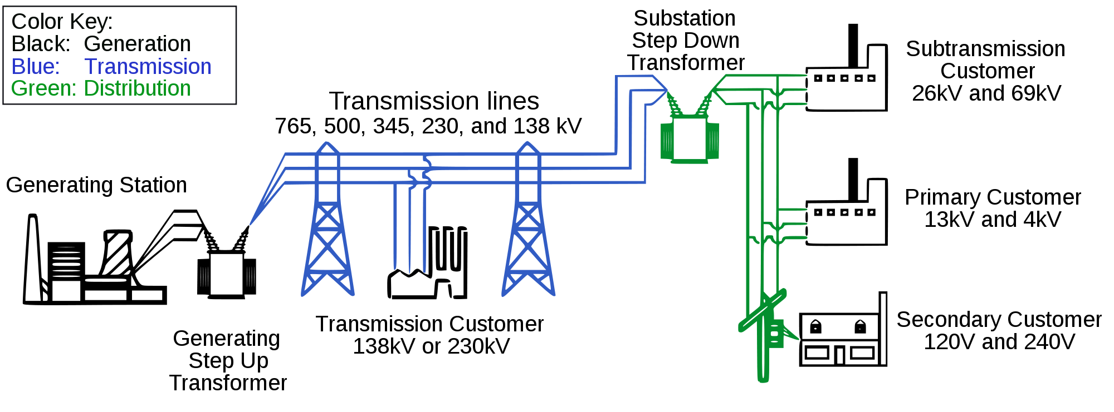
The Future Grid what should it look like
It should be capable of:
Enabling informed participation of customers
Accommodating all generation and storage options
Enabling new products, services, and markets
Providing the power quality for a range of needs
Optimizing asset utilization and operating efficiency
Providing resiliency to disturbances, attacks, and natural disasters
How do we get there?
Grid components and subcomponents
Materials innovations
System integration and distributed technologies
Grid energy storage and demand response
Analysis, standards and model development
Planning, Policy and other non-technical support (e.g., markets, regulations, environmental considerations)
What’s the role of industry?

